Slide 1


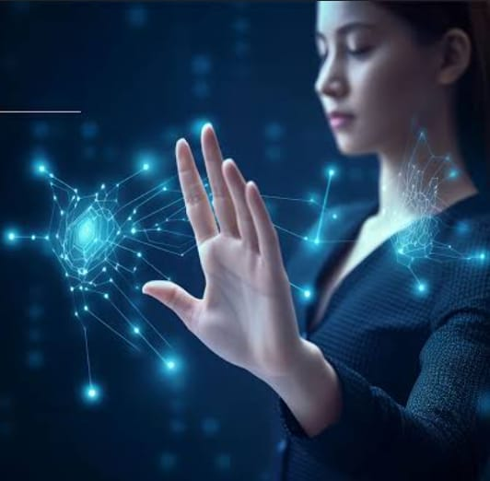
Team Name :- The Immortals
Team Members :-
U. Jenifer (122210602102)
M. Yasaswini (162310602101)
T. Sathvika (122210602101)
Under The Guidence of :
Sambangi.Jayashankar Sir
Gesture-Based Interaction System for Drawing and Screen Brightness Control

Slide 2
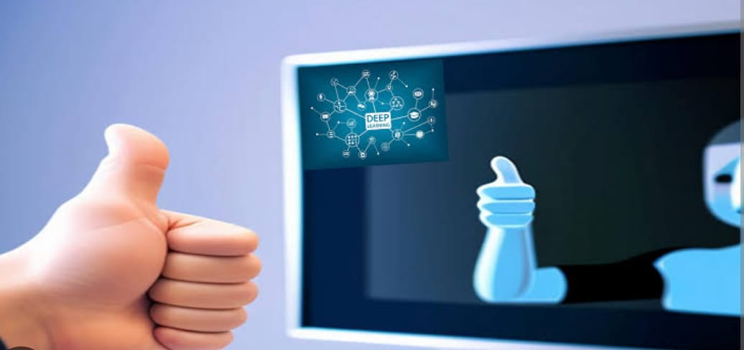
Gesture-Based Interaction System for Drawing and Screen Brightness Control
Introduction :
Human-computer interaction has evolved significantly with the introduction of touch and gesture-based controls. Gesture recognition, in particular, offers a hands-free, intuitive method of controlling devices, which can be particularly useful in scenarios where physical touch is inconvenient or impractical.
This project explores the use of hand gestures for real-time interaction through a webcam. It employs Mediapipe's robust hand tracking system to identify and classify gestures, enabling actions like drawing, brightness control, and canvas clearing. The goal is to provide an accessible, innovative tool for enhancing user interaction through natural gestures, demonstrating the potential of computer vision in everyday applications.

Slide 3
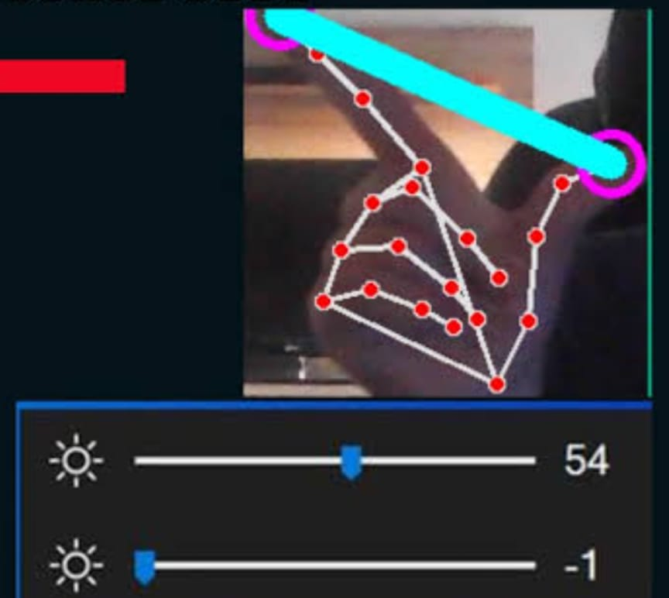
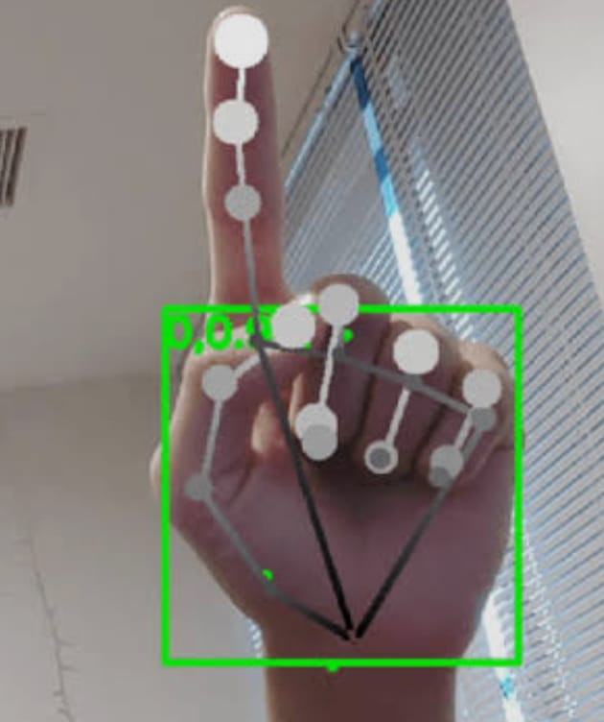
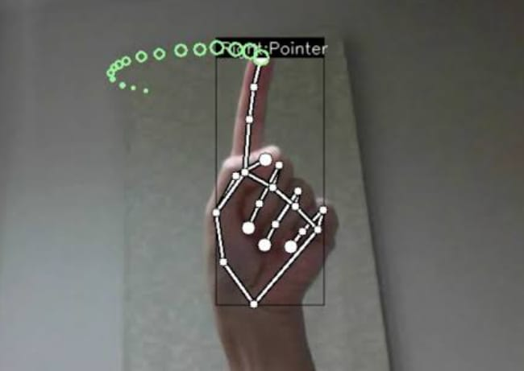
Overview :
This Python program uses a webcam and Mediapipe's Hand Tracking module to perform real-time hand gesture-based tasks. The program enables the following functionalities:
Right-hand gesture for drawing : Draw on a virtual canvas by moving the right index finger.
Left-hand gestures for brightness control : Adjust screen brightness by varying the distance between the left thumb and index finger.
Left-hand shake detection : Clear the drawing canvas by shaking the left hand.
Dependencies :
Required Libraries
cv2 (OpenCV) : For video capture and image processing.
Mediapipe : For hand tracking and landmark detection.
Numpy : For mathematical operations and array handling.
screen_brightness_control (sbc) : For adjusting the screen brightness.
collections.deque : For storing and analyzing recent positions for shake detection.

Slide 4
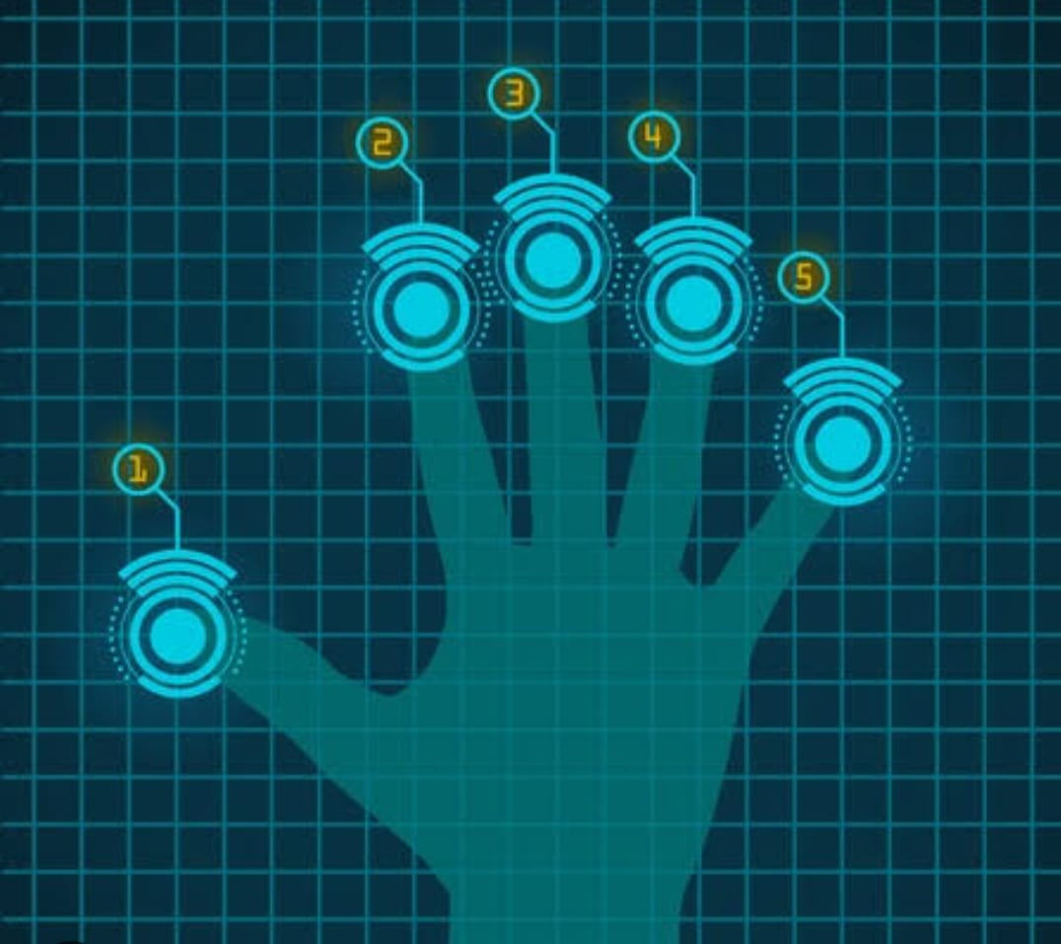
Hardware Requirements:
Camera (Webcam)
Computer (PC/Laptop)
Processor (CPU): Multi-core (e.g., Intel i5 or AMD Ryzen 5)
Memory (RAM): 4 GB minimum (8 GB recommended)
Graphics (GPU): Dedicated GPU (optional)
Storage: 1 GB of free space (SSD recommended)
USB Ports: USB 2.0 or higher for webcam connection
Operating System: Windows, macOS, or Linux
Optional
External Display
Touchscreen (optional for interaction)

Slide 5
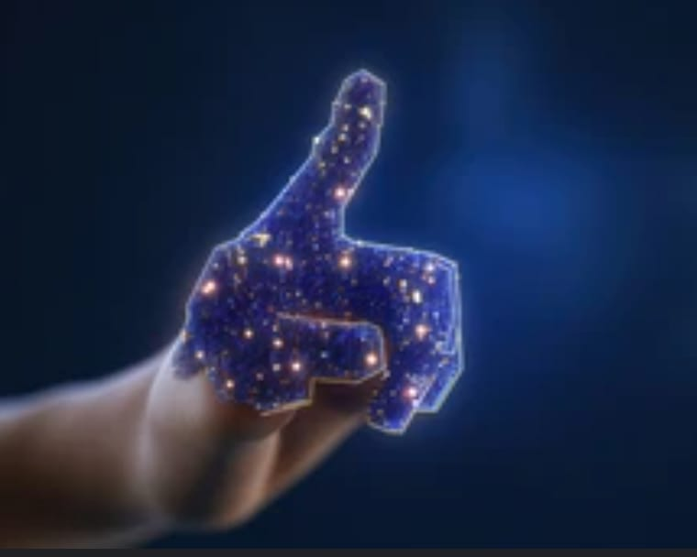
Execution Flow :
Initialization : Initialize the webcam and Mediapipe Hand Tracking.
Capture Frame : Read a frame from the webcam.
Hand Detection : Detect and classify hands (right or left), then process gestures.
Perform Actions :-
Right hand : Draw on the canvas.
Left hand : Adjust brightness or clear the canva.
5. Display : Show the combined video feed and canvas.
6. Exit : Release resources when 'q' is pressed.
Code Functionality
Hand Detection:
The program uses Mediapipe's Hands module to detect and track hands in real-time, distinguishing between the right and left hand by checking the multi_handedness value in the results.
Right-Hand Functionality : Drawing
The program tracks the right index finger to draw lines on a canvas, connecting previous and current positions, displayed over the video feed.
Left-Hand Functionality : Brightness Control
The program measures the distance between the left thumb and index finger, uses that to adjust brightness, and changes the screen brightness with the screen_brightness_control library.
Left-Hand Shake Detection: Clear Canvas
The program tracks the left wrist's movement and clears the canvas if it exceeds a threshold. It uses a deque to store positions and calculates movement by summing Euclidean distances.
Combining Canvas and Video Feed:
The program blends the drawing canvas and the live video feed using cv2.addWeighted, providing a semi-transparent overlay
User Interaction:
The program runs in a loop, displaying the combined video feed, and allows the user to exit by pressing the 'q' key.

Slide 6
.
.
Implementation Approach:
Hand Detection :
The program uses advanced hand-tracking technology to detect and classify hands as "right" or "left.“
It tracks key landmarks, such as fingertips and the wrist, to interpret gestures
Gesture Interpretation :
Right Hand: Tracks the index finger to draw on the canvas.
Left Hand: Measures finger distance to adjust brightness or detects quick movements to clear the canvas
Output Display :
The program combines the real-time video feed with the virtual canvas, blending them into a single interface. This results in a semi-transparent overlay where users can see both their gestures and their actions' effects.
User Interaction :
The user interacts with the system by performing hand gestures, which trigger drawing, brightness control, or canvas clearing, with the program responding accordingly in real-time.
Phase 1
Phase 2
Phase 3
Phase 4
Features :
Drawing : Smooth drawing on a virtual canvas with the right index finger.
Brightness Control : Adjust screen brightness in real time using the left hand.
Shake Gesture : Erase the canvas with a simple shake gesture.

Slide 7
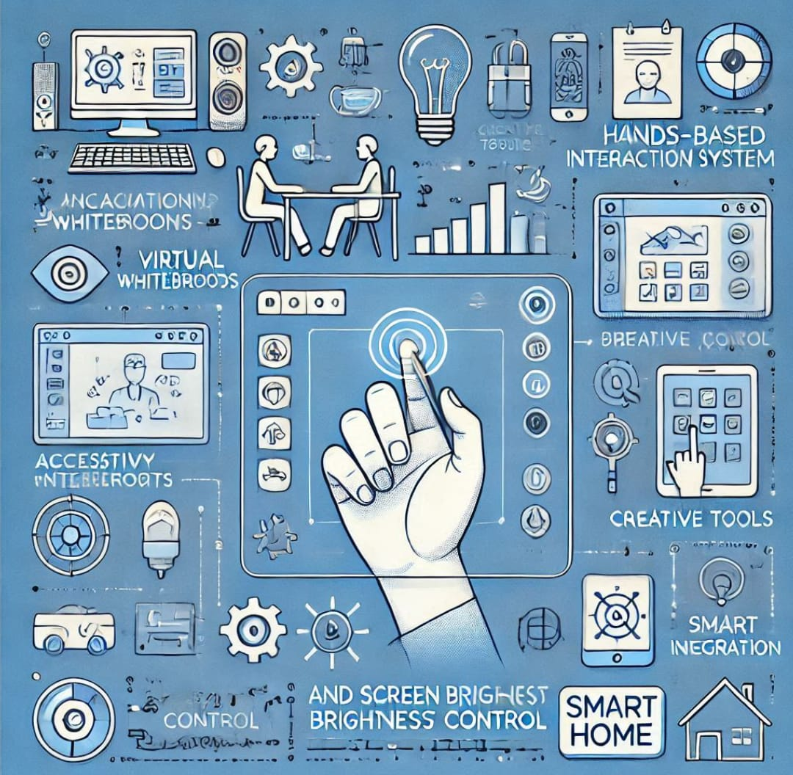
Application :
Interactive Whiteboards: Ideal for virtual classrooms or presentations where annotations can be made in real time.
Accessibility Tools: Enables hands-free screen control for users with mobility challenges.
Creative Tools: Serves as a platform for digital drawing or sketching.
Smart Home Integration: The brightness control mechanism could extend to other devices like smart lights.
limitations :
Lighting Conditions: Poor ambient lighting may reduce the accuracy of hand detection.
Complex Gestures: The system currently supports basic gestures, leaving room for more sophisticated gesture recognition.
Hardware Dependency: Requires a webcam and sufficient processing power for smooth performance.

Slide 8
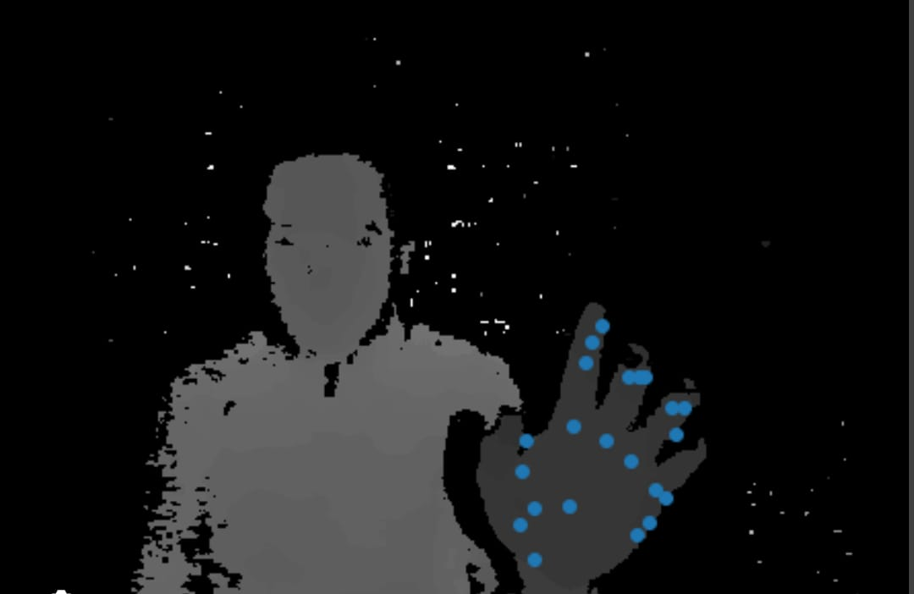
Conclusion : This project demonstrates the power of hand gesture recognition for real-time human-computer interaction. Using advanced hand-tracking, it allows users to draw and write on a virtual canvas, control screen brightness, and reset the workspace with natural gestures. The system shows the potential of touchless controls in applications like interactive whiteboards, accessibility tools, and creative platforms. While the current implementation is functional, there’s room for improvement, such as enhanced gesture recognition, handwriting detection, and broader device integration. In conclusion, the project exemplifies how computer vision and natural gestures can revolutionize user interaction, paving the way for future hands-free technology.

Slide 9
THANK YOU

